Slide 1
Augmented reality

Slide 2
What is Augmented Reality?
Augmented reality (AR) is an interactive experience of a real-world environment where the objects that reside in the real world are enhanced by computer-generated perceptual information, sometimes across multiple sensory modalities.
Simply AR is digital content onto a live camera feed which makes it a part of the physical world.
AR is divided into two main types and six subtypes:
1. Trigger based: They are stimuli that initiate the augmentation. They can be papers, object markers as well as GPS locations.
2. View based: These digitalized objects do not require a reference field to be overlaid, where their location can be manipulated dynamically.

Slide 3
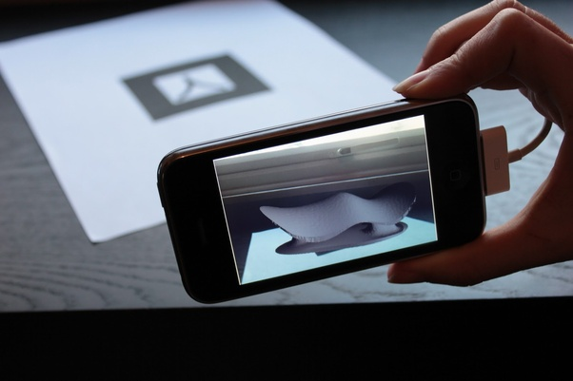
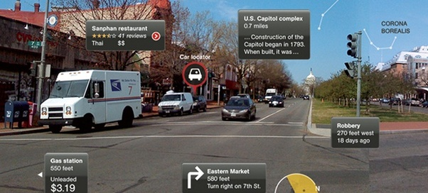

In trigger based, we have three types:
a. Marker-based: This requires a marker to achieve an augmentation. These markers can be paper based or as physical objects of the real world. These augmentations related to the marker enhance the object or the image using digital enhanced 360 degrees model/images

Slide 4
b. Location-based: This utilizes GPS location as a trigger to pair the current location with dynamic information stored as a point of interest. For example: In the following map application, you view dynamically relevant information as per your location
(Used in Pokémon Go and Google Maps Street View)

Slide 5
c. Dynamic Augmentation: This is responsive to the view of the object as it changes. This type of AR also utilizes motion tracking with the scale of the model to identify the right degree of augmentation for the object. (Snapchat & Instagram Face filters)

Slide 6
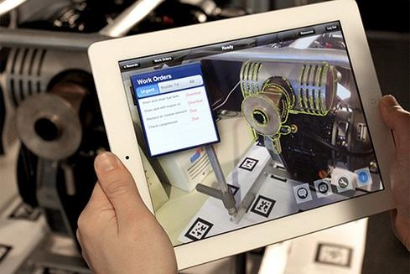
View based can be divided into two types:
a. Superimposition-based : This type of marker-less augmentation uses a static view of the world where external digital models/images can enhance the original environment. Here object recognition is key. For example: During a hands-free maintenance operation, an AR-based glass can detects the hardware equipment and identifies its sub-parts and its relevant information.

Slide 7
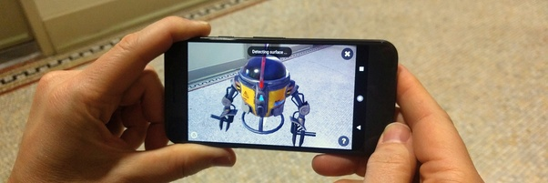
b. Generic Digital Augmentation: This digitizes an object or an asset in the real world without any heed or any reference to the real world environment.
We are using this for our application.

Slide 8
Prerequisites (Hardware & Software)

Slide 9
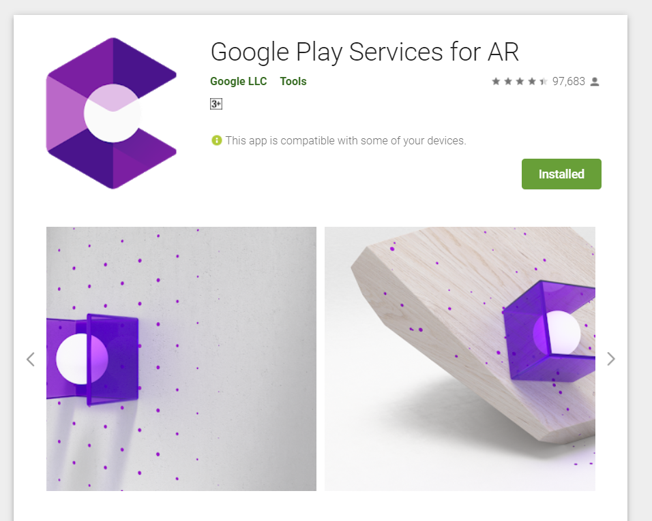
ARCore Supported Device
Android 7.0 +
Google Play Servicesfor AR

Slide 10
Use Cases:
Virtual Showroom
Compare different cars in AR
3D visualization
Digital Manual

Slide 11
How does it really work ??

Slide 12

Motion Tracking

Slide 13
As your phone moves through the world, ARCore uses a process called concurrent odometry and mapping, or COM, to understand where the phone is relative to the world around it. ARCore detects visually distinct features in the captured camera image called feature points and uses these points to compute its change in location. The visual information is combined with inertial measurements from the device's IMU to estimate the pose (position and orientation) of the camera relative to the world over time.
By aligning the pose of the virtual camera that renders your 3D content with the pose of the device's camera provided by ARCore, developers are able to render virtual content from the correct perspective. The rendered virtual image can be overlayed on top of the image obtained from the device's camera, making it appear as if the virtual content is part of the real world.

Slide 14
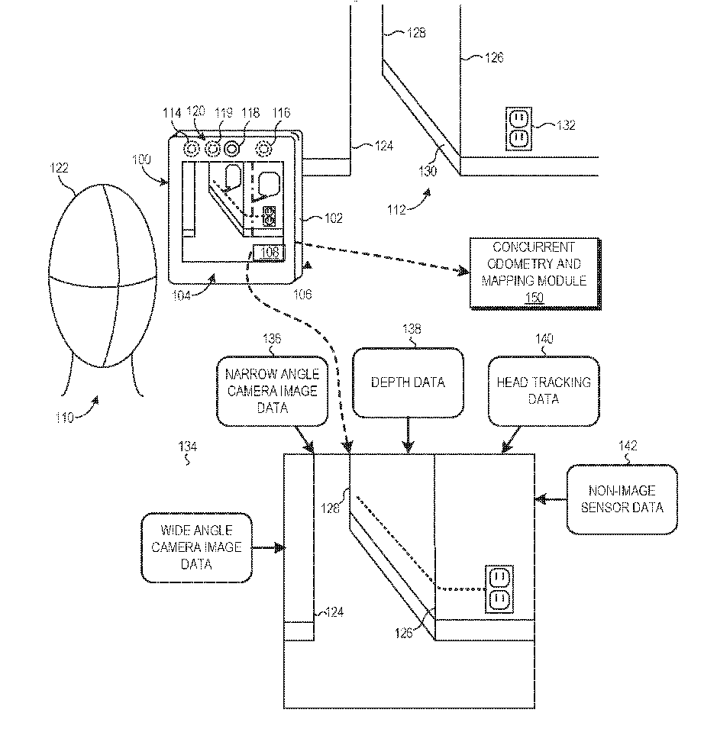

Slide 15

Environmental understanding

Slide 16
ARCore looks for clusters of feature points that appear to lie on common horizontal or vertical surfaces, like tables or walls, and makes these surfaces available to your app as planes. ARCore can also determine each plane's boundary and make that information available to your app. You can use this information to place virtual objects resting on flat surfaces.
Feature points (read corners) in images are points that invariant under view changes, zoom, lightening conditions etc.
Because ARCore uses feature points to detect planes, flat surfaces without texture, such as a white wall, may not be detected properly.

Slide 17
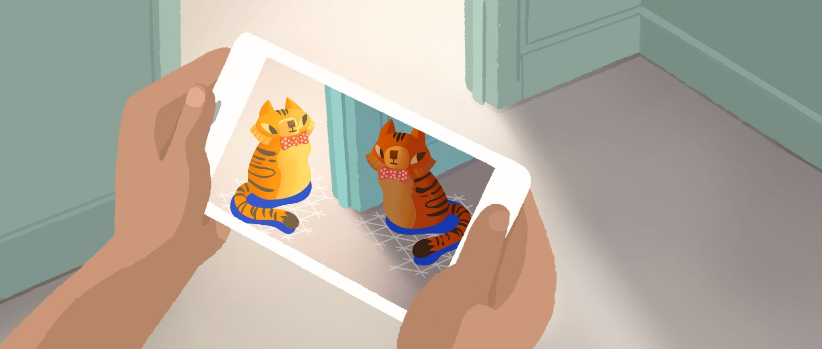
Light estimation

Slide 18
ARCore can detect information about the lighting of its environment and provide you with the average intensity and color correction of a given camera image. This information lets you light your virtual objects under the same conditions as the environment around them, increasing the sense of realism.

Slide 19
Occulsion

Slide 20
User interaction
ARCore uses hit testing to take an (x,y) coordinate corresponding to the phone's screen (provided by a tap or whatever other interaction you want your app to support) and projects a ray into the camera's view of the world, returning any planes or feature points that the ray intersects, along with the pose of that intersection in world space. This allows users to select or otherwise interact with objects in the environment.

Slide 21
Oriented points
Oriented points lets you place virtual objects on angled surfaces. When you perform a hit test that returns a feature point, ARCore will look at nearby feature points and use those to attempt to estimate the angle of the surface at the given feature point. ARCore will then return a pose that takes that angle into account

Slide 22
AR Core's Motion tracking relies on both visual information from the camera and inertial measurements from the device's Inertial measurement unit (IMU).IMU is a collection of sensors like Accelerometer, Compass, Gyroscope, Step detector, Step counter which help to map the 3D graph and locate the object placed.

Slide 23
How Anchors work
If you are new to using anchors, it is helpful to review world space and poses.
World space
Coordinate space in which the camera and objects are positioned
Camera and object positions are updated in world space from frame to frame
Pose
Represents an object’s position and orientation in world space
When you create an anchor, you use a pose that describes a position and orientation relative to the world space estimate for the current frame.

Slide 24
Game Object | Description
ARCore Device | Prefab that manages the ARCore session. Holds the First Person Camera game object, which uses the camera on the back of your device to capture real world images and make them available as the background of the AR scene.
Environmental Light | Prefab that adjusts lighting in the AR scene using an estimate of the average pixel brightness in the image that your camera captures. To do this, in each frame: The EnvironmentalLight controller script gets LightEstimate pixel intensity and color correction values for the captured camera image. The controller script then uses these values to: Generate a normalized pixel intensity value. Set a `_GlobalColorCorrection` shader value.
Point Cloud | Prefab for feature points detected in the current frame.
Example Controller | Game object whose controller script manages the AR scene. The controller script has references to the following game objects: First Person Camera Prefabs for dynamically creating game objects: Detected Plane: Prefab for visualizing detected planes. ARCar: Prefab that users can place in the AR scene. Searching for Plane: UI text element shown during plane detection.
Plane Discovery | Prefab that provides plane discovery visuals that guide users to scan surroundings and discover planes. This consists of an animation of a hand holding the device and a snackbar with short instructions that indicate how to move it so feature points are detected. These feature points have a popup effect to provide feedback when they are detected. If no plane is found after a certain amount of time, the snackbar shows a button that offers to open a help window with more detailed instructions on how to improve the AR experience when pressed.

Slide 25
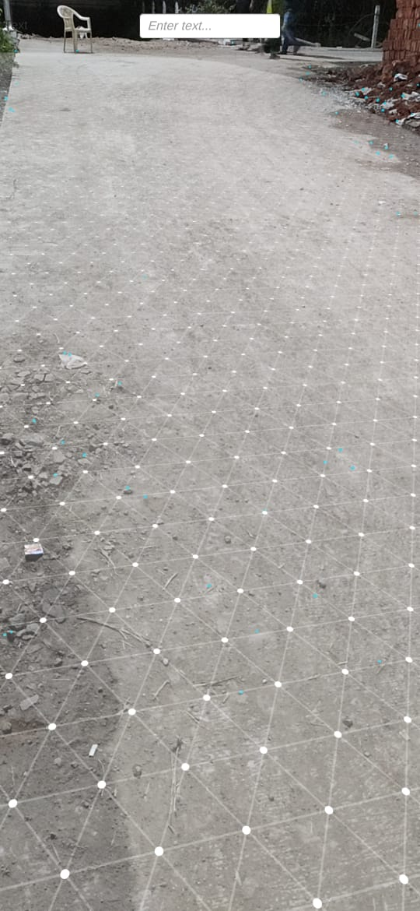
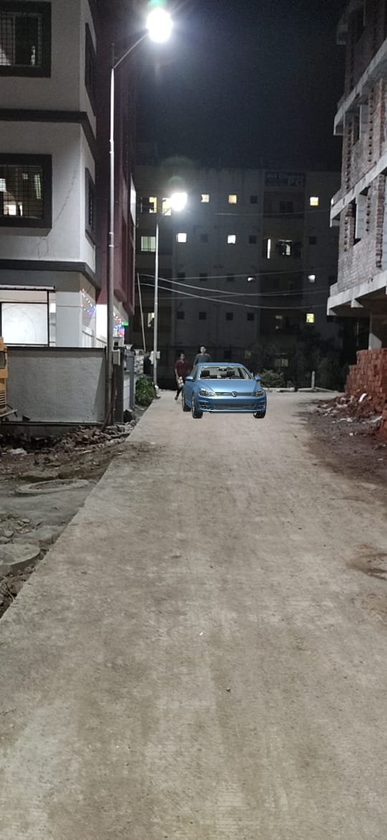
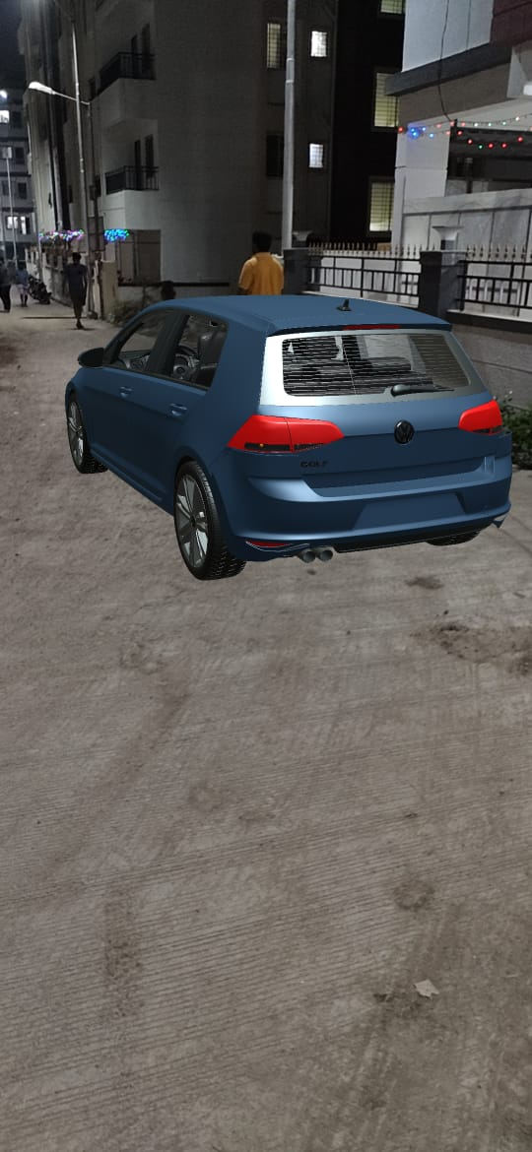
AR Car

Slide 26
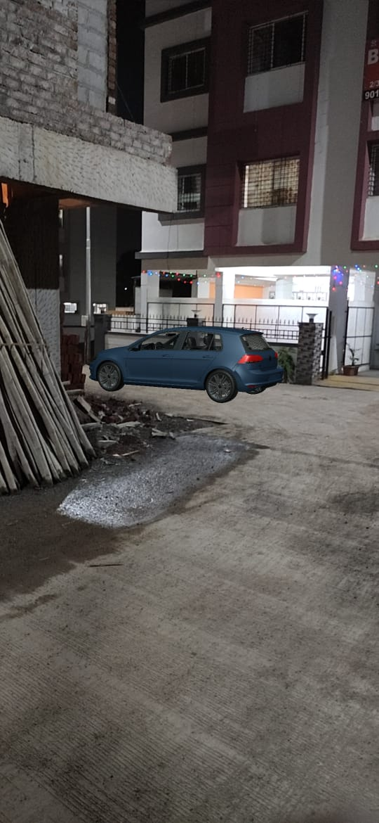
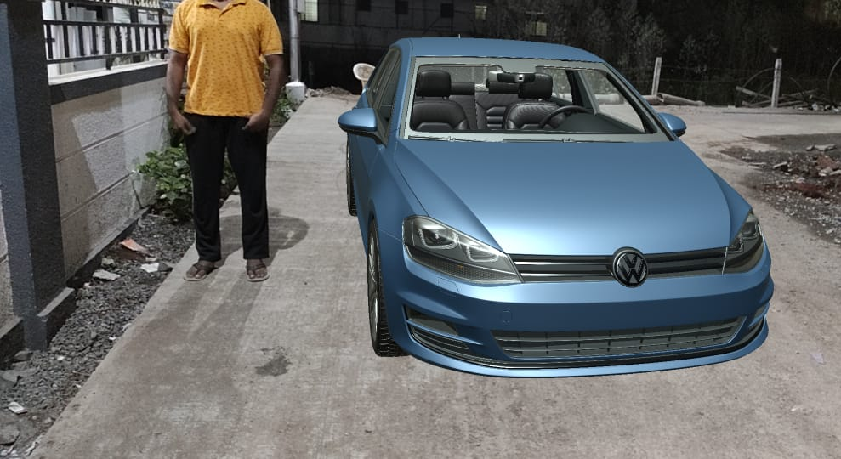

Slide 27
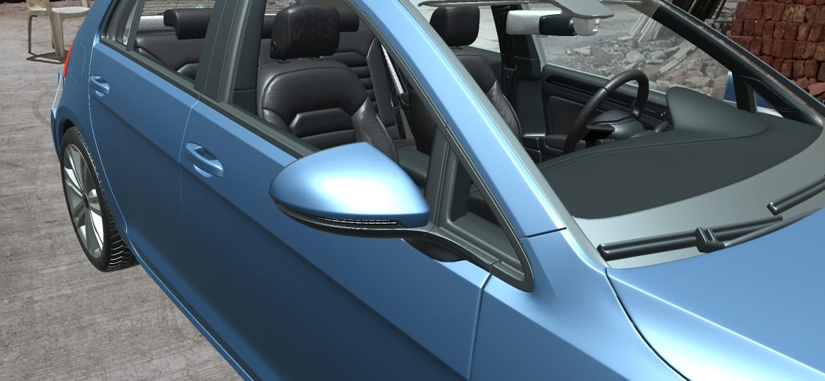

Slide 28
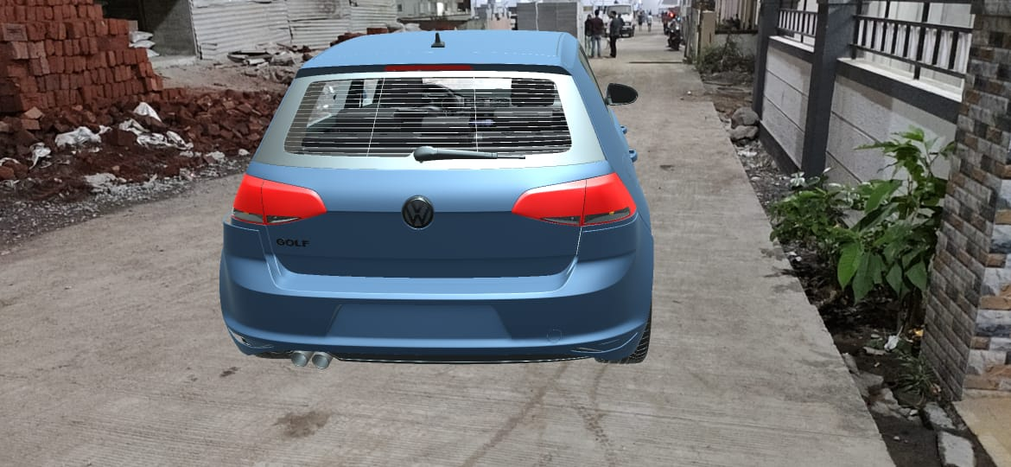

Slide 29
Thank You

